Slide 1
B09S0061 Software Engineering
Lecture 7
Instructor: Liu, Guangchi Ph.D.
2025/04/11
Notes:
本模板基于“中国科学院大学-路人丁-PPT模板”魔改而成，著作权归该作者所有。
本模板中使用的东南大学校徽、校标文字组合、校训文字等素材来自于微信公众号“金木屋”。
本模板的视觉设计参考了“东南大学视觉识别系统”。
人物介绍页头像素材来自 小肥柴。
本模板力求简洁，布局合理，主次分明。以学术风为设计理念，适用于学术报告与论文答辩等相关应用场景。模板未使用任何动画效果。
您仅可以以个人非商业用途使用本PPT模板，不可将信息内容的全部或部分用以出售，或以出租、出借、转让、分销、发布等其他任何方式供其他人使用。
欢迎 持续关注东南大学止于至善学术风 PPT 模板 （https://zhuanlan.zhihu.com/p/335298500）后续的功能优化及多语言更新版本。
最后，祝汇报顺利，马到成功！
Version: (2021) v1.5-en.

Slide 2
Heads Up
2nd Assignment will be uploaded to 微助教 on Apr 14th, 23:55 pm， due on Apr 21st, 23:55 pm

Slide 3
Heads Up
1st Lab: Apr 12nd, 14:00 – 17:25, J6-102 (temporarily)
Each team will present to TA or Instructor:
Project name
Team members
Feasibility Study
Development Process
Project Schedule
Requirements (analysis/elicitation, modeling, specification)

Slide 4
Heads Up
Prepare the following questions (10 pts for each question )
Q1 Does you team have management/technical expertise? How will you handle personnel change (sick, unavailable, etc.)?
Q2 What are the benefits of the project?
Q3 Is your project technically feasible? What is the scope of your project?
Q4 What are the recourses (human, equipment, tools, IPs) and budgets you will need?
Q5 Any risk? How to minimize it? Any alternatives? Why still go with this one?
Q6 What is the schedule of the project? Estimated Arrival Time of each task? Date for final delivery?
Q7 What are the requirements of your project? How did you identify them?
Q8 Who are the stakeholders (user, customer, clients) where the requirements come from?
Q9 Did you go through the scenario and draw the use case diagrams for each type of stakeholder?
Q10 Any requirement modeling diagram used in your project?

Slide 5
01
PART ONE
Security

Slide 6
Security in Development Process
The security goal
• Ensure availability for legitimate use
• Prevent malicious use
• Preserve privacy
• Security is a property of the entire system
• Only as strong as the weakest link (which may not be software)
• Very difficult to improve after system is designed
• Appropriate security measures requires threat modeling
Security considerations need to be part of the entire software development process.
They may have a major impact on the system architecture chosen.

Slide 7
Economics of security
Security is a difficult property to quantify/develop/verify
Secure development practices are expensive
Engineer/researcher with specific skills/knowledges
Little evidence that customers will pay extra for better security
Many risks are borne externally
Overall system security limited by weakest link
But software insecurities are scalable, brittle
once discovered, exploitation may be rapid and widespread
Networked systems allow compromise to propagate to increasingly critical systems
Future societal costs may be enormous

Slide 8
Economics of security
Annual cost of poor software quality: $2 trillion
75% due to security vulnerabilities
Annual cost of cybercrime: $6 trillion
Ransomware damages: $20 billion
Escalating risk of cyber warfare
One lecture will not make you an expert
Familiarize terminology and context
Avoid common mistakes

Slide 9
Security Functions and Dangers
Functions
Secrecy: control of who gets to read information
Integrity: control of how information changes or resources are used
Availability: providing prompt access to information and resources
Accountability: knowing who has had access to resources
Dangers
Damage to information — integrity
Disruption of service (denial of service) — availability
Theft of money — integrity
Theft of information — secrecy
Loss of privacy — secrecy

Slide 10
Security Issues
System Security
System vulnerabilities
Network Security
Network Attack
Encryption
Cryptography
AI Security
AI model vulnerabilities, Differential Privacy
Sensing Security
Human-Computer Interface
Content Security
Disinformation Attack, AIGC

Slide 11
Perfect security is impractical
Security risks are used to be treated as a cost of doing business
Fines
Identity protection services
Loss of customers
Cost of required fixes
Loss of confidential information (trade secrets, export-controlled data)
Loss of system availability
Blackmail & ransom
Theft & fraud
Security risks are currently more like a national security concern!

Slide 12
Security within an Organization: People
Many security problems come from people inside the organization.
In a large organization, there will be some dishonest and disgruntled people
Dishonest
Malicious
Security relies on trusted individuals. What if they are not trustworthy?
People are intrinsically insecure.
Easy to be impacted
Example: Social Bot, Disinformation Attack, Zero-Trust Environment

Slide 13
Design for Security: People
Make it easy for responsible people to use the system and hard for untrustworthy people
Example: Trust evaluation upon users
Train people in responsible behavior
Educate people be cautious about unverified information

Slide 14
External Intruders
All network systems are vulnerable to security breaches by external intruders
Modern software is so complex that it is impossible to eliminate all vulnerabilities
Many skilled individuals and organizations are continually seeking to discover and exploit new vulnerabilities.
Many governments regularly break into computer systems

Slide 15
External Intruders
Examples of external security vulnerabilities:
Unauthorized access — modify software, install listening devices
Backdoors — bypass authentication
Denial of service — overload and other forms of blocking
Eavesdropping
Spoofing （xxx@seu.com.cn）
Phishing
etc., etc.

Slide 16
External Intruders: Online Data
Online systems capture and save large amounts of private data:
Shopping sites: names, addresses, credit cards (e.g., Target)
Financial systems: financial data, ID numbers, credit data
Social media: friends, search terms, location data (e.g., Facebook)
If this data is hacked:
Damage to the users:
Financial losses (e.g., credit ratings)
Emotional losses (e.g., medical history)
Damage to the companies running the systems
Fines (or even criminal charges)
Legal settlements for damages
Loss of customers
Technical costs of fixing problems
National Security Issues

Slide 17
External Intruders: Minimizing Risk
There is no way to guarantee security from external intruders, but careful software development can make a major difference.
How to minimize the risks:
System/Interface design — secure protocols, authentication, barriers to access
Programming — defensive programming and rigorous testing
Operating procedures — backup, auditing, vulnerability testing
Training and monitoring personnel

Slide 18
Minimizing Risks: Dependency
Software security depends on entire stack
Hardware
Operating system & services
Library dependencies
Build tools & runtime environment
Application itself
Trusted & secret data
Risk management requires policy and planning
Stay up-to-date with security updates (may require downtime)
Stay up-to-date with revocation lists, certificate renewal
Balance availability against security (timeline for phasing out support for insecure versions)

Slide 19
Minimizing Risks: System Architecture
The system architecture can minimize risks in various ways:
Secure protocols, e.g., HTTPS encryption.
Authentication:
Encryption of passwords in transmission and when stored
Two factor authentication (effective but can be inconvenient)
Face Recognition
Barriers, e.g., firewalls, private networks, and virtual private networks.
Data security, e.g., encryption of stored data, backup.

Slide 20
Minimizing Risks: Online Data
Data collection
Collect only essential data.
Delete unused data.
Encrypt sensitive data.
Perform security audits regularly.
Be prepared for trouble
Back up all data.
Know the privacy laws.
Have a disaster plan:
leadership
message to users
public relations
technical recovery procedures

Slide 21
Security Techniques: Barriers
Place barriers that separate parts of a complex system:
Isolate components, e.g., do not connect a computer to a network
Firewalls
Require authentication to access certain systems or parts of systems
Every barrier imposes restrictions on permitted uses of the system.
Barriers are most effective when the system can be divided into subsystems.
Example. Integration of Internet Explorer into Windows

Slide 22
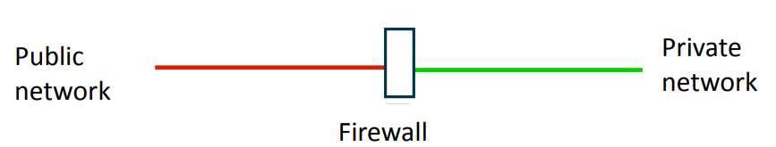
Barriers: Firewall
A firewall is a computer at the junction of two network segments that:
Inspects every packet that attempts to cross the boundary
Rejects any packet that does not satisfy certain criteria, e.g.,
An incoming request to open a TCP connection
An unknown packet type
Firewalls provide increased security at a loss of flexibility, inconvenience for users, and extra system administration.

Slide 23
Security Techniques: AuthN and AuthZ
Authentication (AuthN) establishes the identity of an agent:
What does the agent know (e.g., password)?
What does the agent possess (e.g., smart card)?
What does the agent have physical access to (e.g., crt-alt-del)?
What are the physical properties of the agent (e.g., fingerprint)?
Authorization (AuthZ) establishes what an authenticated agent may do:
Access control lists
Group membership

Slide 24
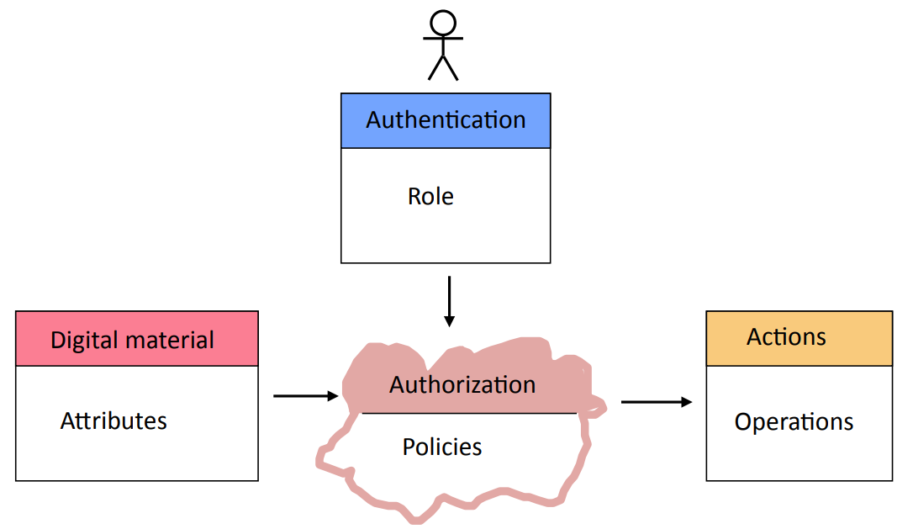
Example: An Access Architecture for Digital Content

Slide 25
Access control technologies
OpenID/OIDC (authentication)
SSH keys (authentication)
LDAP (identity, authentication, authorization)
Kerberos (SSO authentication)
Supported by both Unix and Windows
SAML/Shibboleth (web SSO authentication & authorization)

Slide 26
Network security & barriers
In practice, access control is often linked to network presence
Denial-of-service attacks can affect resources without needing to authenticate
Firewalls, private networks, and airgaps provide isolation
Partition system components into trust domains
Combine with access controls at other layers (defense in depth)
Bridges are often easy to construct
Cloud Computing/XX as a service becomes a challenge
More generally, barriers can be a useful tool when systems are divided into subsystems

Slide 27
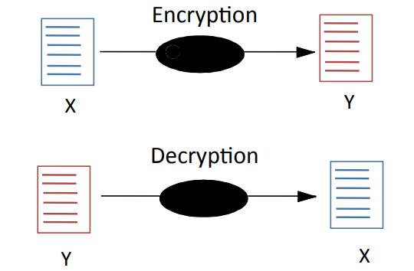
Communication Security Techniques: Encryption
Allows data to be stored and transmitted securely, even when the bits are viewed by unauthorized agents and the algorithms are known.
Asymmetric/Symmetric Encryption
Digital Signature

Slide 28
Communication security
Integrity – do received bits match transmitted bits?
Checksums and hashes protect against accidental corruption
Trusted hashes can detect deliberate manipulation
Authenticity – can recipient verify that message was sent by claimed sender?
Message Authentication Codes (MACs) provide authenticity if parties share a secret key
Non-repudiation – can a third party verify that message was sent by claimed sender?
Digital signatures allow verification against public key (but higher overhead)

Slide 29
Communication security (continued)
Confidentiality – only the intended recipient can read the message
Provided by encryption
Building blocks
Authenticated Encryption with Associated Data (AEAD) + public key crypto
(Historically, block ciphers + hash functions + public key crypto)
HTTPS protocol is a standard solution!

Slide 30
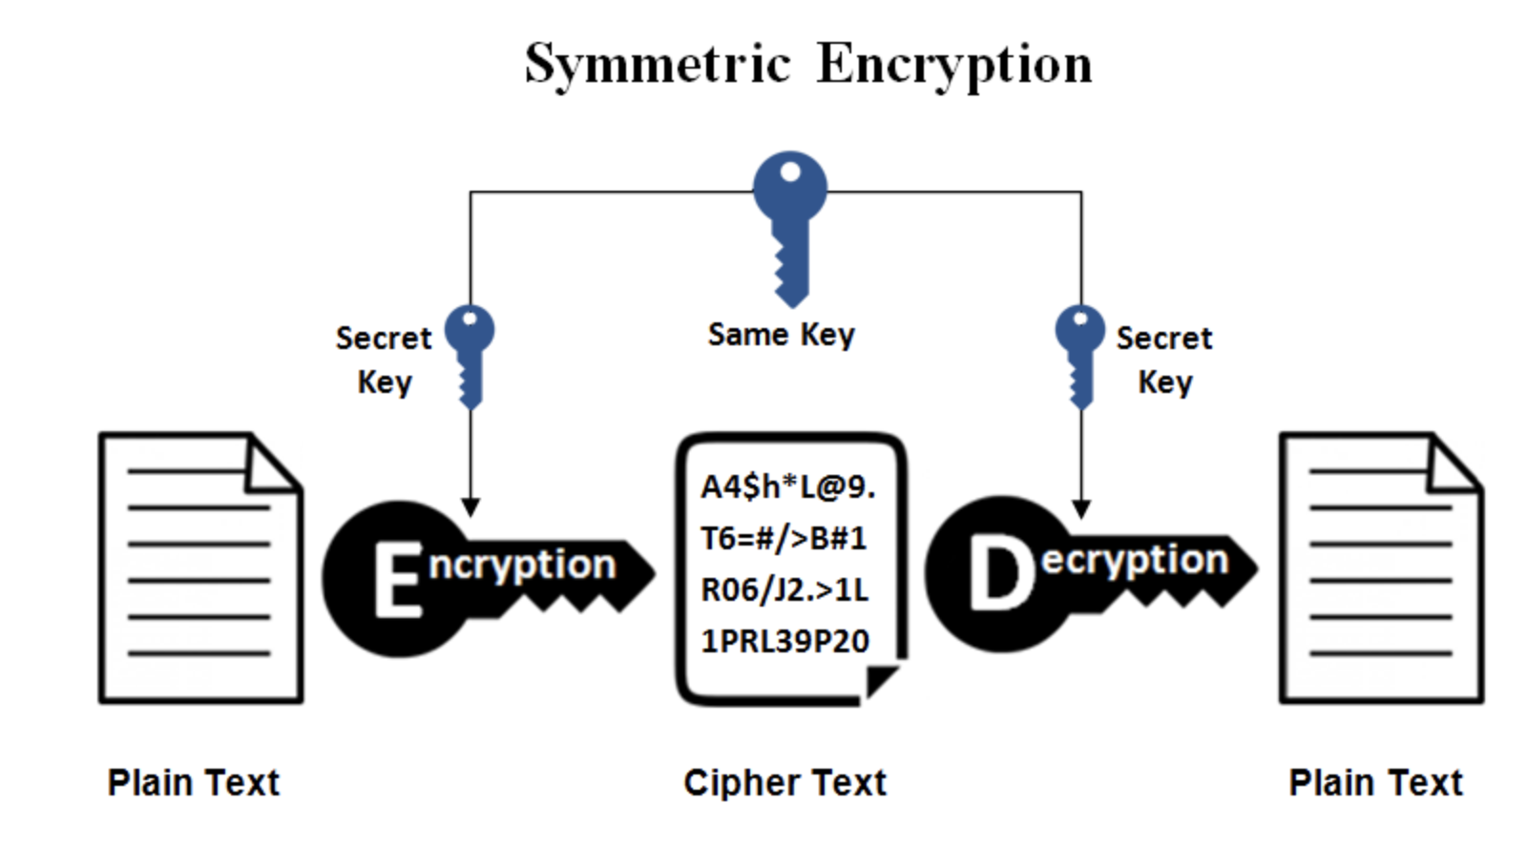
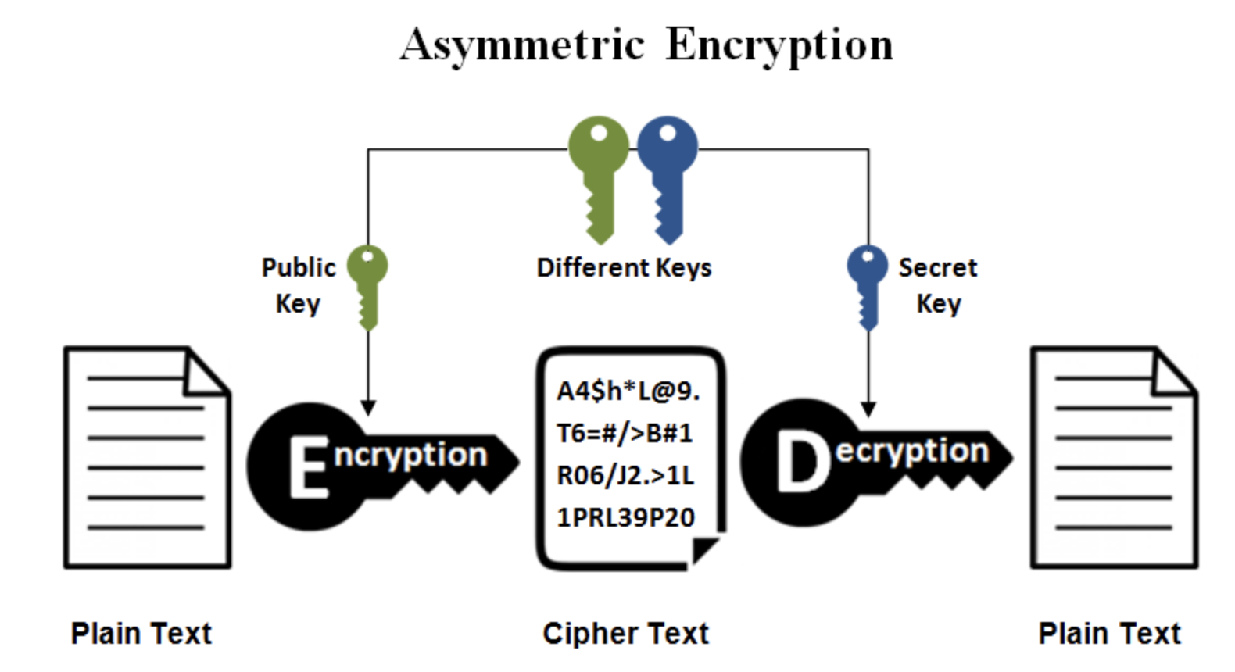
Asymmetric vs. Symmetric
Asymmetric Encryption
Generated by one side, only public key is shared
Secure, but high overhead for PC
X
Y
Symmetric Encryption
Generated by one side, shared among multple sides
Fast, but risky (key distribution)
X
Y

Slide 31
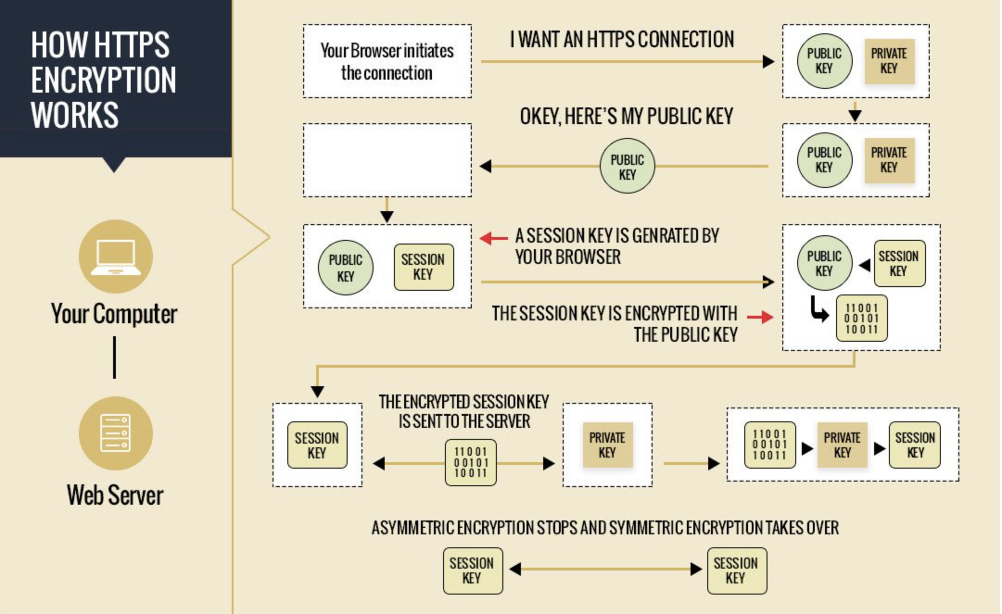
HTTPS
C
S
C
Certificate
Verification
S
Certificate
C
C
C
C
S
S
S
C
S

Slide 32
Minimizing Risks: Programming
The software development challenge:
Develop secure and reliable components
Protect whole system so that security problems in parts of it do not spread to the entire system
A large system will have many agents and components:
Each is potentially unreliable and insecure
Components acquired from third parties may have unknown security problems
The commercial off-the-shelf problem:
Developers of off-the-shelf software have considerable incentives to supply software that has many options and features
In developing such software rapidly they have fewer incentives to be thorough about security.

Slide 33
Programming Secure Software
Programs that interface with the outside world (e.g., web sites, mail servers) need to be written in a manner that resists intrusion.
For the top 25 programming errors, see: Common Weakness Evaluation: A Community-Developed Dictionary of Software Weakness Types http://cwe.mitre.org/top25/
Insecure interaction between components
Risky resource management
Porous defenses
Project management and test procedures must emphasize that programs avoid these errors.

Slide 34
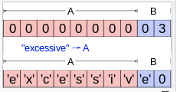
Security bugs
Computers can execute code or commands that should not be authorized
Buffer overflow: user-provided bytes stored in memory are overwritten
Privilege escalation: authenticated user is able to perform operations that are only authorized for more privileged users
Example: system services
Injection: software treats user-provided data as instructions
Examples: printf, SQL, HTML/JS, quotes
Web pages are especially vulnerable (mix data and code)
XSS: Get a trusted page to deliver content that refers to malicious JavaScript
CSRF: Get authenticated web browser to submit malicious requests to a service provider

Slide 35
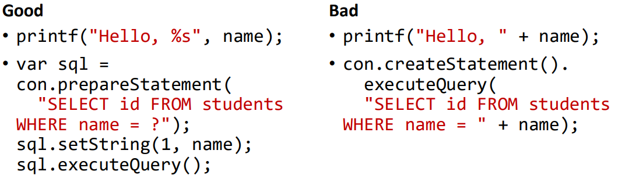
SQL injection

Slide 36
SQL Injection
What if name = ‘XXX' OR 'a'='a’

Slide 37
SQL Injection
What if name = ‘XXX' OR 'a'='a’

Slide 38
Mitigating injection attacks
Avoid splicing parameters into command strings yourself
Make use of placeholders and APIs accepting additional arguments
Input validation
Never rely on client-side validation alone
Taint tracking
Tag all values derived from user input;
only allow use after passed through appropriate validation function

Slide 39
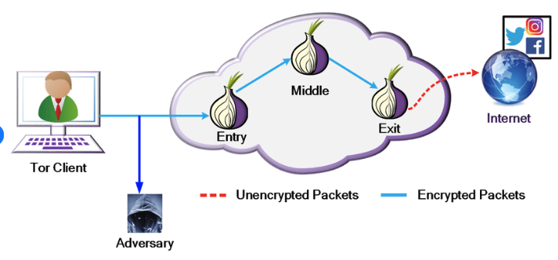
Side channel attacks
Timing, power consumption, emissions can reveal secrets
Can be mitigated with specialized techniques
Or occasionally by blunt ones with higher cost
Example: Injecting randomness in network communication

Slide 40
Catching/avoiding security bugs
Need most advanced techniques for ensuring software quality
Expensive, not scalable
Focus community effort, leverage established components, stay up-to-date
Prefer simplicity (unfortunately, standards have accommodated complexity)
Techniques:
Code review, expert audits
Testing (fuzzing)
Static & dynamic analysis (taint tracking, memory checking)
Formal verification
Defense in depth

Slide 41
Sandboxing
Defense in depth: assume application can be compromised; how can damage be contained?
Examples:
Java security manager
Processes vs. threads (Chrome tabs)
Containers and virtual machines

Slide 42
Minimizing Risks: Procedures
The operating procedures must anticipate security problems.
A senior member of staff must have responsibility for security.
Equipment
Keep system software up to date with latest security patches.
Run up to date virus checking software.
Rules about passwords, personal equipment, and non-standard software should be explicit.
Routine checks
Run network security tests regularly.
Run password checkers.
Example: Carnegie Mellon
Training
Keep staff informed about security. Ask for their advice.

Slide 43
Operations: Recovery
Sooner or later every system fails because of hardware, software, operational, or security problems.
The operating procedures must anticipate loss of data and damage to systems, which can happen at any moment.
Backup techniques
At regular intervals check point the system.
At regular intervals backup all data.
Keep full audit trails of all important transactions
Recovery software
Recovery software is complex. It needs to be tested regularly in realistic situations.
A good practice is to rebuild the entire system, but this may not be possible with large collections of data.
Use Docker!

Slide 44
Security in Development Process
Conclusion
You can never guarantee that a system is completely secure, but you can do a great deal to minimize the risks and to be able to recover from problems.

Slide 45
02
PART TWO
Performance

Slide 46
Performance of Computer Systems
Performance is important
A single bottleneck can slow down an entire system
Future loads may be much greater than predicted
Performance is a straightforward KPI！

Slide 47
When Performance Matters
Real time systems when computation must be fast enough to support the service provided, e.g., fly-by wire control systems have tight response time requirements.
Very large computations where elapsed time may be measured in days, e.g., calculation of weather forecasts must be fast enough for the forecasts to be useful.
User interfaces where humans have high expectations, e.g., mouse tracking must appear instantaneous.
Transaction processing where staff need to be productive and customers not annoyed by delays, e.g., High Frequency Trading
Resource constrained systems where small devices still need to do big things

Slide 48
High-Performance Computing
High-performance computing:
Large data collections with many transactions (e.g., Taobao)
Huge numbers of users (e.g., TikTok)
Large computations (e.g., weather forecasting)
Must balance cost of hardware against cost of software development
Some configurations are very difficult to program and debug
Sometimes it is possible to isolate applications programmers from the system complexities

Slide 49
Performance Challenges for all Software Systems
Tasks
Predict performance problems before a system is implemented.
Design and build a system that is not vulnerable to performance problems.
Identify causes and fix problems after a system is implemented.

Slide 50
Performance Challenges for all Software Systems
Basic techniques
Understand how the underlying hardware and networks components interact with the software when executing the system.
For each subsystem calculate the capacity and load. The capacity is a combination of the hardware and the software architecture.
Identify subsystems where the load is near peak capacity.
Example
Calculations indicate that the capacity of a search system is 1,000 searches per second. What is the anticipated peak demand?

Slide 51
Interactions between Hardware and Software
Examples
In a distributed system, what messages pass between nodes?
How many times must the system read from disk for a single transaction?
What buffering and caching is used?
Are operations in parallel or sequential?
Are other systems competing for a shared resource (e.g., a network or server farm)?
How does the operating system schedule tasks?

Slide 52
Look for Bottlenecks: CPU Performance
CPU performance is a limiting constraint in certain domains, e.g.:
large numerical calculation
mathematical computation (e.g., feature engineering)
compression and encryption
multimedia (e.g., video)
perception (e.g., image processing)

Slide 53
Look for Bottlenecks
BUT, CPU performance is usually not the limiting factor, as multi-core machines are common today
Hardware bottlenecks
Reading data from disk
Shortage of memory (including paging)
Moving data from memory to CPU
Network capacity
Inefficient software
Algorithms that do not scale well (e.g., in legacy systems)
Parallel and sequential processing

Slide 54
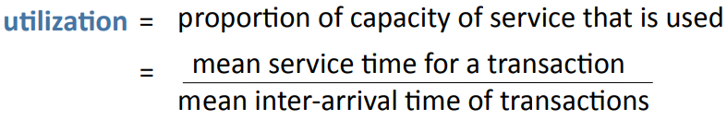
Look for Bottlenecks: Utilization
Utilization is the proportion of the capacity of a service that is used on average.
When the utilization of any hardware component exceeds 0.3, be prepared for congestion.
Peak loads and temporary increases in demand can be much greater than the average.

Slide 55
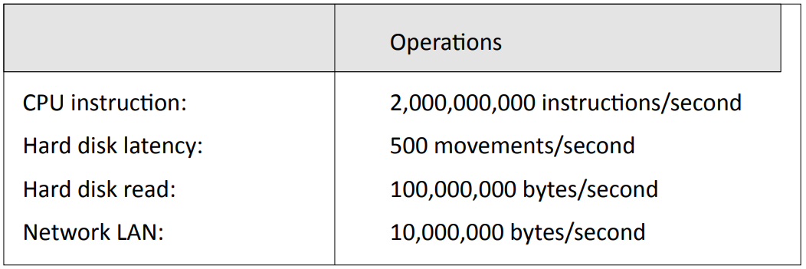
Timescale of Different Components
Actual performance may be considerably less than the theoretical peak

Slide 56
Predicting System Performance
Direct measurement on subsystem (benchmark)
Mathematical models (queueing theory)
Simulation
All require detailed understanding of the interaction between software and hardware systems.

Slide 57
Mathematical Models
Queueing theory
Good estimates of congestion can be made for single-server queues with:
Arrivals that are independent, random events (Poisson process)
Service times that follow families of distributions (e.g., negative exponential, gamma)
Many of the results can be extended to multi-server queues.
Much of the early work in queueing theory by Erlang was to model congestion in telephone networks.

Slide 58
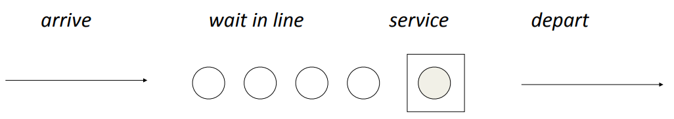
Mathematical Models: Queues
Single server queue
Examples
Requests to read from a disk (with no buffering or other optimization)
Customers waiting for check in at an airport, with a single check-in desk

Slide 59
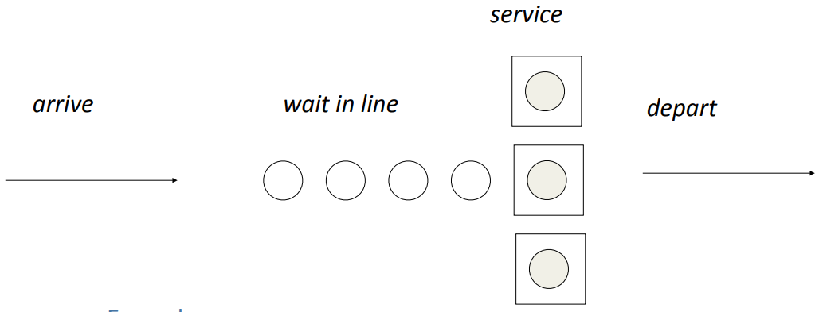
Queues
Multi-server queue
Examples
Tasks being processed on a computer with several processors
Customers waiting for check in at an airport, with several check-in desks

Slide 60
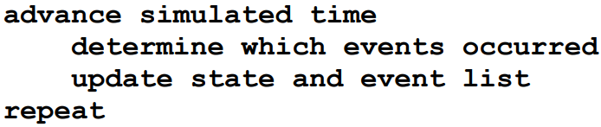
Techniques: Simulation
Build a computer program that models the system as set of states and events.
Discrete time simulation: Time is advanced in fixed steps (e.g., 1 millisecond)
Next event simulation: Time is advanced to next event
Events can be simulated by random variables (e.g., arrival of next customer, completion of disk latency), or by using data collected from an operational system.

Slide 61
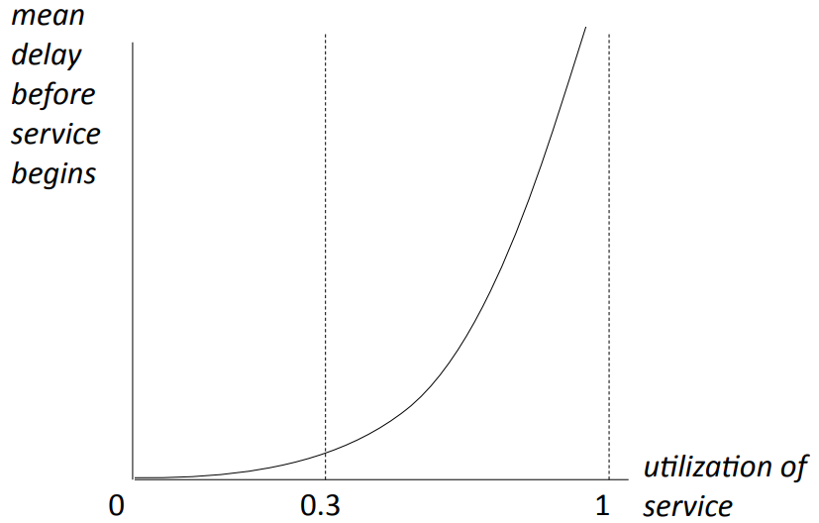
Behavior of Queues: Utilization
The exact shape of the curve depends on the type of queue (e.g., single server) and the statistical distributions of arrival times and service times.

Slide 62
Measurements on Operational Systems
Measurements on operational systems
Benchmarks: Run system on standard problem sets, sample inputs, or a simulated load on the system.
Instrumentation: Clock specific events.
If you have any doubt about the performance of part of a system, experiment with a simulated load.

Slide 63
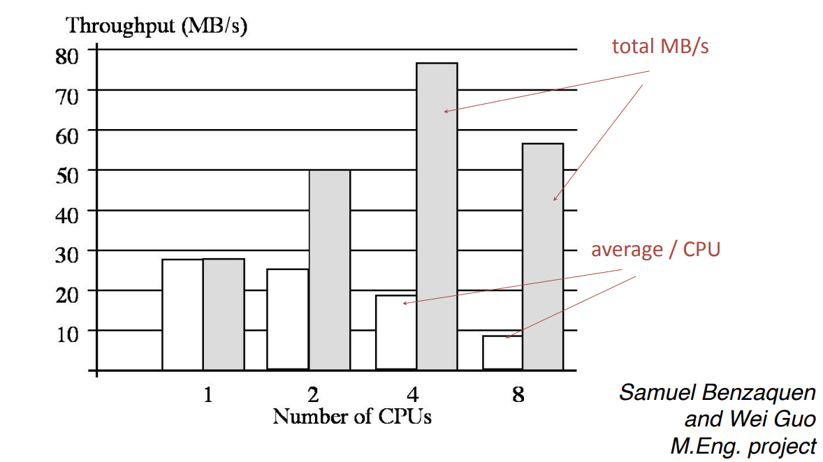
Example: Web Laboratory
Benchmark: throughput v. number of CPUs on a symmetric multiprocessor

Slide 64
Fixing Bad Performance
If a system performs badly, begin by identifying the cause:
Instrumentation. Add timers to the code. Often this will reveal that delays are centered in a specific part of the system.
Test loads. Run the system with varying loads, e.g., high transaction rates, large input files, many users, etc. This may reveal the characteristics of when the system runs badly.
Design and code reviews. Team review of system design, program design, and suspect sections of code. This may reveal an algorithm that is running very slowly, e.g., a sort, locking procedure, etc.
Find the underlying cause and fix it or the problem will return!

Slide 65
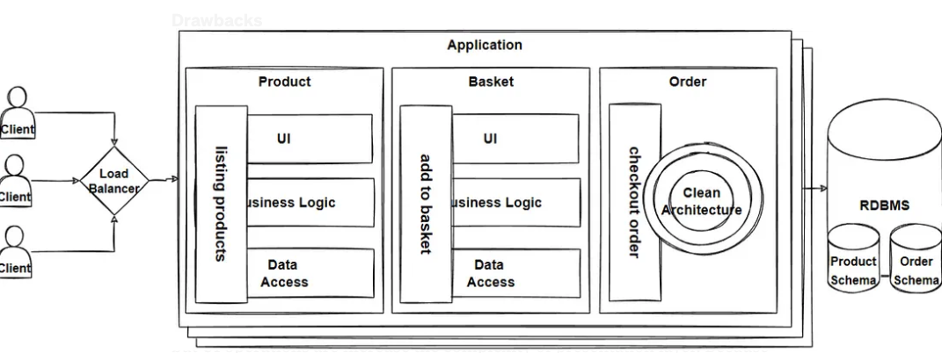
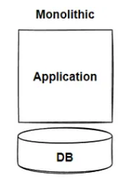
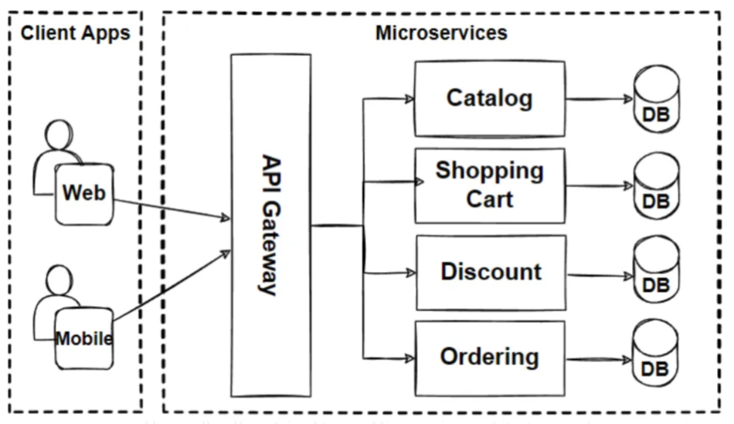
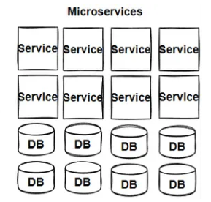
Improving Performance
Special purpose hardware
Graphics processors (e.g., Nvidia)
Algorithm/data structure design
Time/Space Complexity
Special Database/Data warehouse
Hive, ClickHouse
Parallel processing
Spark, Kubernetes (K8s)

Slide 66
Thoughts for the Future
Current trends in high performance computing
High performance applications require ever increasing parallel computing, cluster computing, and cloud computing.
The performance of networks is critical — both the throughput and the latency.
Data centers are becoming huge and extremely complex.
Software developers
A small number of developers are creating this distributed, parallel infrastructure.

